Slide 1

Strategic Information Systems Management Section 4 Business IT / IS Alignment Class Code: COMP423 H.Y Kan, Stanley Room: (WUI CHI) - 4/F, N46B Email: hykan@ipm.edu.mo Tel: 8599-6883

Slide 2
Learning Objectives
Understand the concepts of business alignment and IT/IS alignment from both an academic and practitioner perspective
Understand the concept of the value of business/IT architecture (re)alignment
Appreciate the key frameworks/approaches for architecture-driven modernization of IT architecture
Develop a practical approach to supporting organizations to achieve symmetry in their IT/IS alignment endeavours

Slide 3
Introduction
We understand that a lot of the contents are related to e-commerce. We now turn to strategic implications and planning of information systems in e-business, where firms may not be in the IT sector and information systems tend to play a more supportive role in the business.
Strategic information systems include any information that can change, support and inform strategic goals and objectives of a business, or can influence its ability to manipulate the environmental relationships it has (for example, with customers or suppliers).
IT/IS alignment focuses on how to fuse the capability of technology, systems and information with the needs and aspiration of the business.

Slide 4
Business Alignment
Overall Business Strategy
Operation
Marketing
Sales
Finance
HR
Information Systems
Business alignment is concerned with “linking and configuring the strategic elements, key organization systems, processes and structure in such a way that their implementation achieves the organization’s shared vision and results beyond expectations.”
Business alignment helps to improve business processes, reduces operational costs, and promotes real-time visibility in business performance.
In general terms, business alignment crosses through all major business functions: operation, marketing, sales, finance, human resources, research and development, etc.
IT/IS Alignment

Slide 5
Business Alignment (Cont’d)
Strategic alignment is not just focused on the inside of the company, but also on its external environment, competitors, suppliers and customers.
In the past, information systems planning was typically a subsequent activity when the business direction has already be set, without consideration of the IT/IS perspectives.
However, to be effective, the strategy should be robust but also agile, able to accommodate a rapidly changing business environment and respond to new challenges.
Business Strategy
IS Planning
Business Strategy
IS Planning
Past
Present

Slide 6
IT/IS Alignment
Henderson and Venkatraman (1993) describe IT/IS alignment as the degree of “fit” or the “support” to ensure the integration of IT into the business strategy by alignment between and within four domains:
Business strategy
IT strategy
Organizational infrastructure
IS infrastructure and processes
Ward and Peppard (2003) and Bannister and Remenyi (2005) argue that alignment is about achieving a purposeful connection between strategy, organization, processes, technology and people.

Slide 7
IT/IS Alignment (Cont’d)
IT/IS Alignment can be assessed in five dimensions
Strategic and intellectual dimension: The state in which IT and business objectives are consistent, valid, and working in harmony. It requires IT/IS staff to know about the business and the business to know about the capacity and capability of IT/IS.
Structural dimension: Refers to the degree of structural fit between the technology, business processes and those who use or are served by technology. This degree of fit is influenced by the power and political base and the location of the key players who decide on IT/IS issues.
Informal structural dimension: It refers to the relationship-based structure that cuts across the formal structural boundaries that exist for the management of functional work activity. These informal networks include the social networks, communities of practice, cross departmental relationships, unofficial agreed-on processes and flexible divisions of work that are present within the organization.

Slide 8
IT/IS Alignment (Cont’d)
Social dimension: Refers to the state in which business and IT executives in an organizational unit understand and are committed to each other’s mission and plans; in other words, how well committed are people to one another and to the collective ambition/aspiration of the “tribe.”
Cultural dimension: It is the degree to which the corporate culture promotes the future between IT/IS function and the business.

Slide 9
Business Benefits of IT/IS Alignment
Organizational agility: if IT/IS develops in an iterative manner without holistic consideration of current or future business needs, systems are likely to become diverse and incapable of scaling or adapting over time.
Operational efficiency: modern business relationships are complex, involving a blend of customers, suppliers, service providers and other third parties. By effective alignment of IT/IS to the needs of these relationships, business can improve their operational efficiency with consequent competitive advantage.
IT cost reduction: where IT/IS is developed in an iterative manner without focus on the organization’s wider alignment needs, multiple solutions may be developed or procured to similar business needs, increasing IT capital costs and providing fragmented solutions that are more difficult and expensive to support.
Risk management: the discipline of alignment planning forces an organization to consider the effectiveness of its systems against a diverse range of factors. This highlights potential commercial or legal compliance risks and promotes thorough system revisions.

Slide 10
IT/IS Alignment and Enterprise Architecture
Osterwalder et al. (2005) recommend the use of Enterprise Architecture modeling to achieve IT/IS alignment,
Enterprise architecture (EA) has in the past been used for different purposes. Lately, the term has more prominently been used to indicate the planned integration of strategic IS planning and organizational strategy.
Enterprise architecture is the practice of applying a comprehensive and rigorous method for describing a current or future structure for an organization’s processes, information systems, personnel and organizational sub-units so that they align with the organization’s core goals and strategic direction.
It promotes the use of modeling and planning at different levels and from different perspectives to ensure the overarching impact of decisions and changes are understood.
Two of the best known enterprise architecture approaches are the Zachman framework and The Open Group Architecture Framework (TOGAF) (currently the most popular framework).

Slide 11
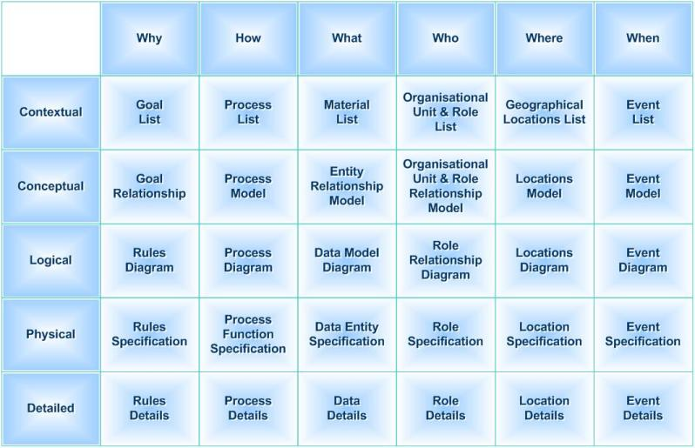
The Zachman Framework
First developed by John Zachman in 1980s.
It is an enterprise ontology and is a fundamental structure for Enterprise Architecture which provides a formal and structured way of viewing and defining an enterprise.
The ontology has 2 dimensions:
Six basic interrogatives
Six distinct perspectives (Planner, Owner, Designer, Builder and Worker)

Slide 12
TOGAF
The Open Group Architecture Framework (TOGAF) is a framework for enterprise architecture that provides an approach for designing, planning, implementing, and governing an enterprise information technology architecture. TOGAF is a high level approach to design (Wikipedia.com).
It is typically modeled at four levels:
Business architecture: defines the business strategy, governance, organization and key business processes or the organization
Application architecture: provides a blueprint for the individual application systems to be deployed, the interactions between the application systems and their relationships to the core business processes of the organization
Data architecture: describes the structure of an organization’s logical and physical data assets and the associated data management resources
Technology architecture: describes the hardware, software and network infrastructure needed to support the deployment of core, mission-critical applications.
An introduction

Slide 13
Academically-Based Toolkits for IT/IS Alignment
Grant et al. discussed four toolkits four academically-based toolkits for IT/IS Alignment
Earl’s Multiple Methodology
Henderson and Venkatraman’s Strategic Alignment Model
Luftman’s Maturity (IT/IS) Assessment Model
Capability Maturity Model Integration
Here, we will only go through the first two toolkits

Slide 14
Earl’s Multiple Methodology (1993)
The key ideological stance taken by Earl is based not on internal but external or outward looking activities so that business objectives can be met fully.
Earl pioneered a multiple methodology with three approaches:
Top-down: is concerned with identifying and agreeing business objectives and the drivers of business value through interviews, debate, existing business strategy and policies. Critical success factors are then developed for areas where success is necessary for survival, and subsequently information systems that support/enable/deliver these critical success factors need to be found.
Bottom-up: is about exploring what currently exist in terms of hardware, software, IT and IS applications and determining their functions, and how they work and add value. This activity also requires an understanding of any capacity limits or constraints of current systems, which might act as a barrier to future needs.

Slide 15
Earl’s Multiple Methodology (1993) (Cont’d)
Inside-out: is about being innovative and finding novel ways of giving the business an advantage. Usually, this needs strategic thinking into state of the art knowledge of other sectors/companies and spotting potential technologies or application of technologies, which will be ground-breaking in the near future.
Earl suggests that both top-down and bottom-up methods should be used for IT/IS strategic planning and alignment since this gives a comprehensive overview of the situation from all angles.
The inside-out methods imply designing an organizational and technological environment which enables innovations to happen, thus making it possible to gain competitive advantage from IT/IS.

Slide 16
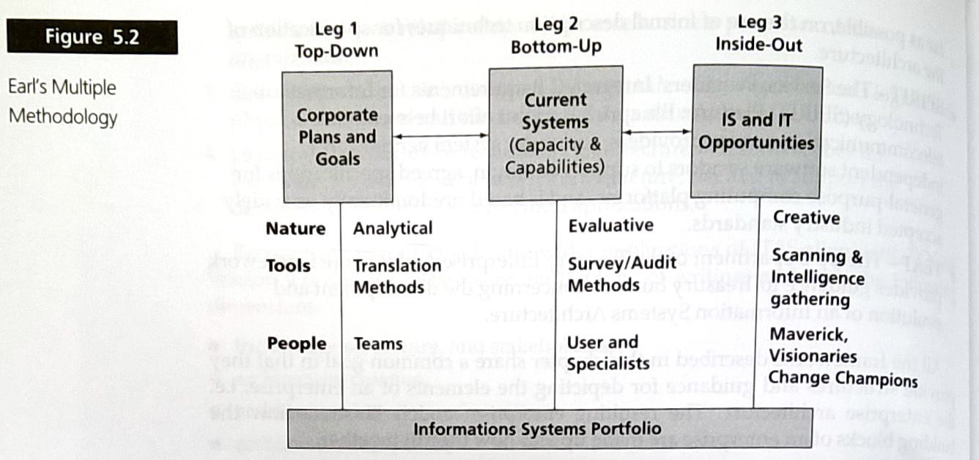
Earl’s Multiple Methodology (1993) (Cont’d)

Slide 17
Strategic Alignment Model
Developed by Henderson and Venkatraman (1993)
Focuses on four main components
Business
Business Strategy
IT
IT Strategy
The model allows users to conceptualize strategic alignment in terms of two dimensions:
Strategic fit (between the internal and external domain)
Functional integration (between the business and IT domain)

Slide 18
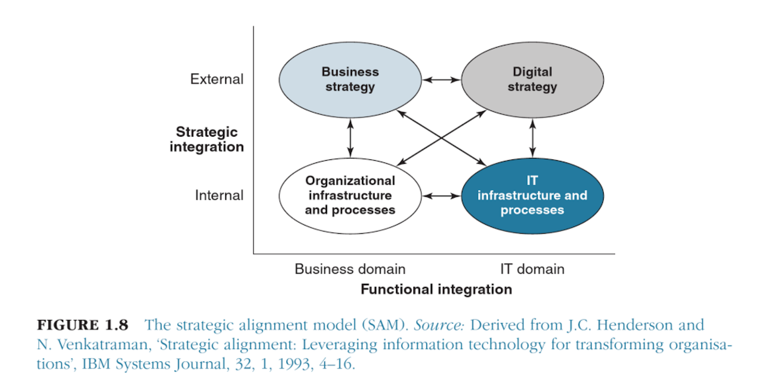
Strategic Alignment Model (Cont’d)

Slide 19
Strategic Alignment Model (Cont’d)
The hypothesis of the model is that in order to generate value, all four quadrants must be coordinated.
The strategic alignment model makes two significant contributions to the area of IT/IS alignment:
Recognition that it is not just the business strategies that need to fit with the environment, but also the IT strategy.
Recognition that strategic alignment is not only concerned with the alignment of strategies but also with the alignment of business and IT infrastructure.

Slide 20
Practitioner’s Challenges
The following are some challenges and areas meriting focus in achieving IT/IS alignment:
Business context: The first step in aligning IT with business is to understand that business. The goals, systems and processes of the target organization need to be researched, as does the environment in which these exist. The capabilities and strategies of competitors are equally important, as are those business partners. Alignment needs to be forward looking and consider the future business context.
Scope: The scope and boundaries of the organization and IT under consideration must be clearly defined. Many large organizations have complex functional and geographical boundaries that divide different stakeholder groups with conflicting commercial or technological interests.
Level of depth: Another key consideration is the level of depth to which business and IT alignment will be addressed. Scope and depth are key to determining who needs to be consulted and the amount of data gathering required.

Slide 21
Practitioner’s Challenges (Cont’d)
Hypothesis and anticipation: Alignment may be achieved by different ways. Practitioners should explore and test possible options at as early a stage as possible. With early hypothesizing and visioning of future state, analysis and research can be focused on validating or disproving key candidate options, resulting in a more robust and supportable outcome.
The human dimension: there are many factors that may cause people to behave in ways that are seemingly dysfunctional to the needs of business/IT alignment. Humans are resistant to change and may develop strong, yet seemingly illogical attachments to failing projects and organizational structures.
Flexibility and pragmatism: Different techniques for achieving alignment have their own advantages and disadvantages that may affect their utility in different circumstances. If the business strategy has not been defined, simple Strengths, Weaknesses, Opportunities and Threats (SWOT) and critical success factors analysis may be more effective than more complex alignment models.

Slide 22
Chapter Summary
Key learning points from Grant et al. Chapter 5:
Business alignment is concerned with linking and configuring strategic elements, key organization systems, processes and structure in such a way that their implementation achieves the organization’s shared vision.
IT/IS alignment centres on three arguments: organizational performance depends on structures and capabilities that support the successful realization of strategic decisions; alignment is a two-way process, where business and IS strategies act as mutual drivers.
The benefits of having IT/IS alignment are organizational agility, operational efficiency, IT cost reduction and risk management.
“Enterprise Architecture” is used as a process by which the planned integration of information, the information architecture, IT and IS to and with organizational strategy happens.

